Slide 1
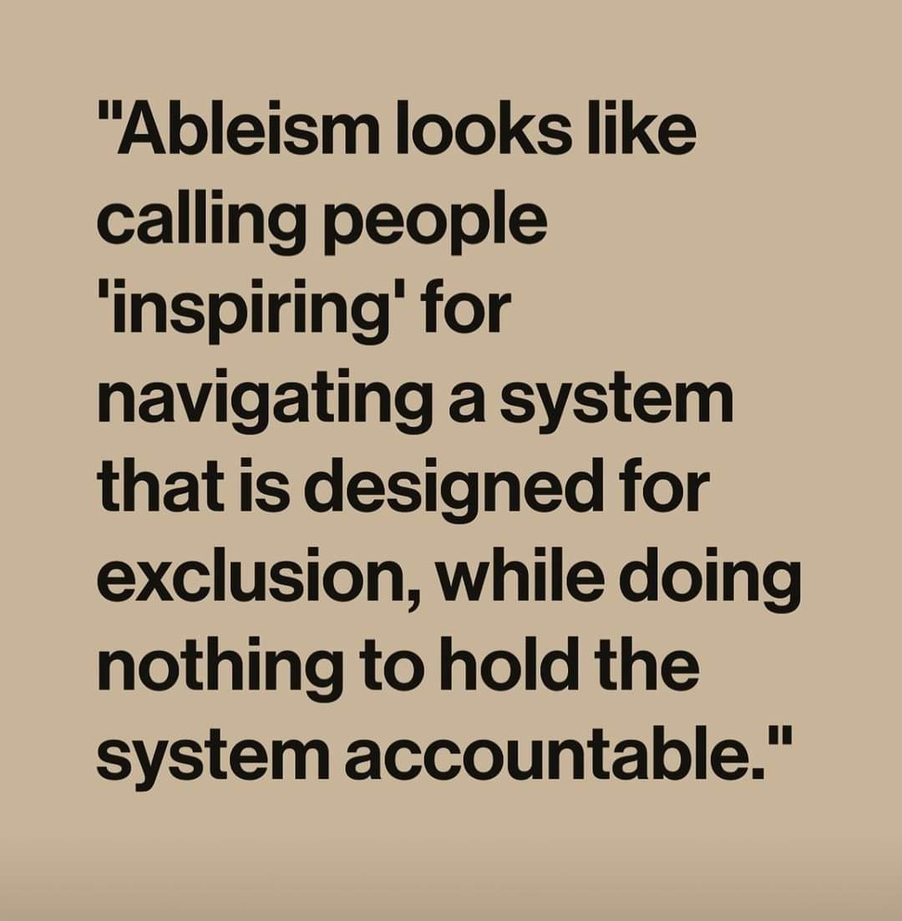

Slide 2
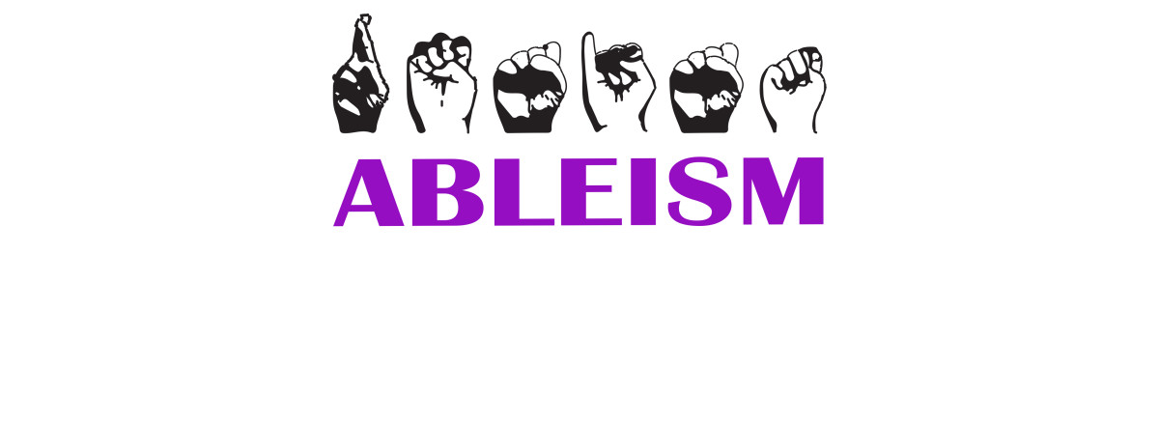
What is ableism? How does it affect my life?
Ableism is a harmful way of viewing people with disabilities
It affects both people with disabilities and those without disabilities in many ways
It implies that people with disabilities need to be “fixed” and it puts someone’s disability before other things about them - their personalities, their likes and dislikes, etc
Ableism affects how people are treated in lots of different ways - in places like hospitals, restaurants, schools, stadiums for watching sports, jobs, concert venues, bars, etc
It also affects how we talk to each other and how other people talk to us

Slide 3
What are some examples of ableism?
Assuming that everyone in a wheelchair cannot walk
Not installing a ramp at a store with a step because “people with disabilities don’t come into the store” (assuming that people with disabilities don’t go out or wouldn’t be customers in their store)
Talking to people with Autism or people with intellectual disabilities like they are a baby (assuming they can’t understand you)
Parking in an accessible parking spot when you do not need one (ignoring basic needs of people with disabilities or assuming no one will need the space)
Not having accessible bathrooms (again, ignoring basic needs of disabled people) - if you can’t use the bathroom at a restaurant, that’s a restaurant you can’t go to)

Slide 4
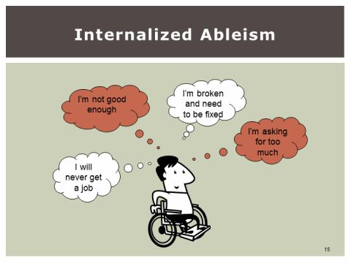
Internalized ableism
Sometimes we judge others with disabilities, and sometimes we judge ourselves because we have a disability.
Example: Meredith didn’t believe she was worthy of having a romantic relationship because she walks different, uses a wheelchair, and has a lot of anxiety. She also is afraid of being judged when she goes out with friends because she is different.

Slide 5
Signs that you might have some internalized ableism:
You feel like a burden asking for help with your disability
You compare yourself to other people without disabilities and feel “not good enough” if you can’t do the same things as abled people or do things slower than other people (like getting your degree in college or getting your own housing)
It is okay! It is okay to be different and it is okay to DO things differently! Just because you do things differently or talk differently does NOT make you less important than other people. It does not mean that you deserve less than other people.

Slide 6
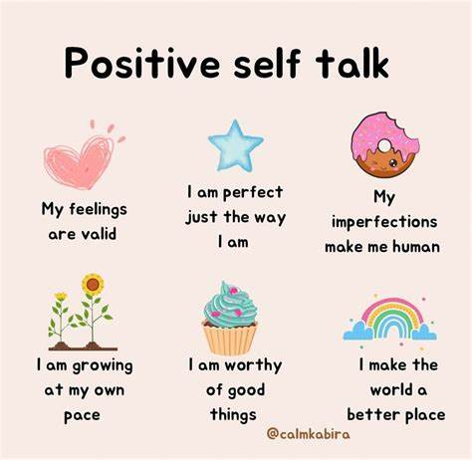
There will always be people who will judge you or not understand you. That isn’t your fault or something you need to fix. Be yourself and the right people will love and accept you for who you are. Be kind to yourself, not just other people!

Slide 7
