Slide 2
New Year Check-In!
Words of Affirmation
Vision boards
Health goals
Employment goals
Education goals
Misc goals

Slide 3
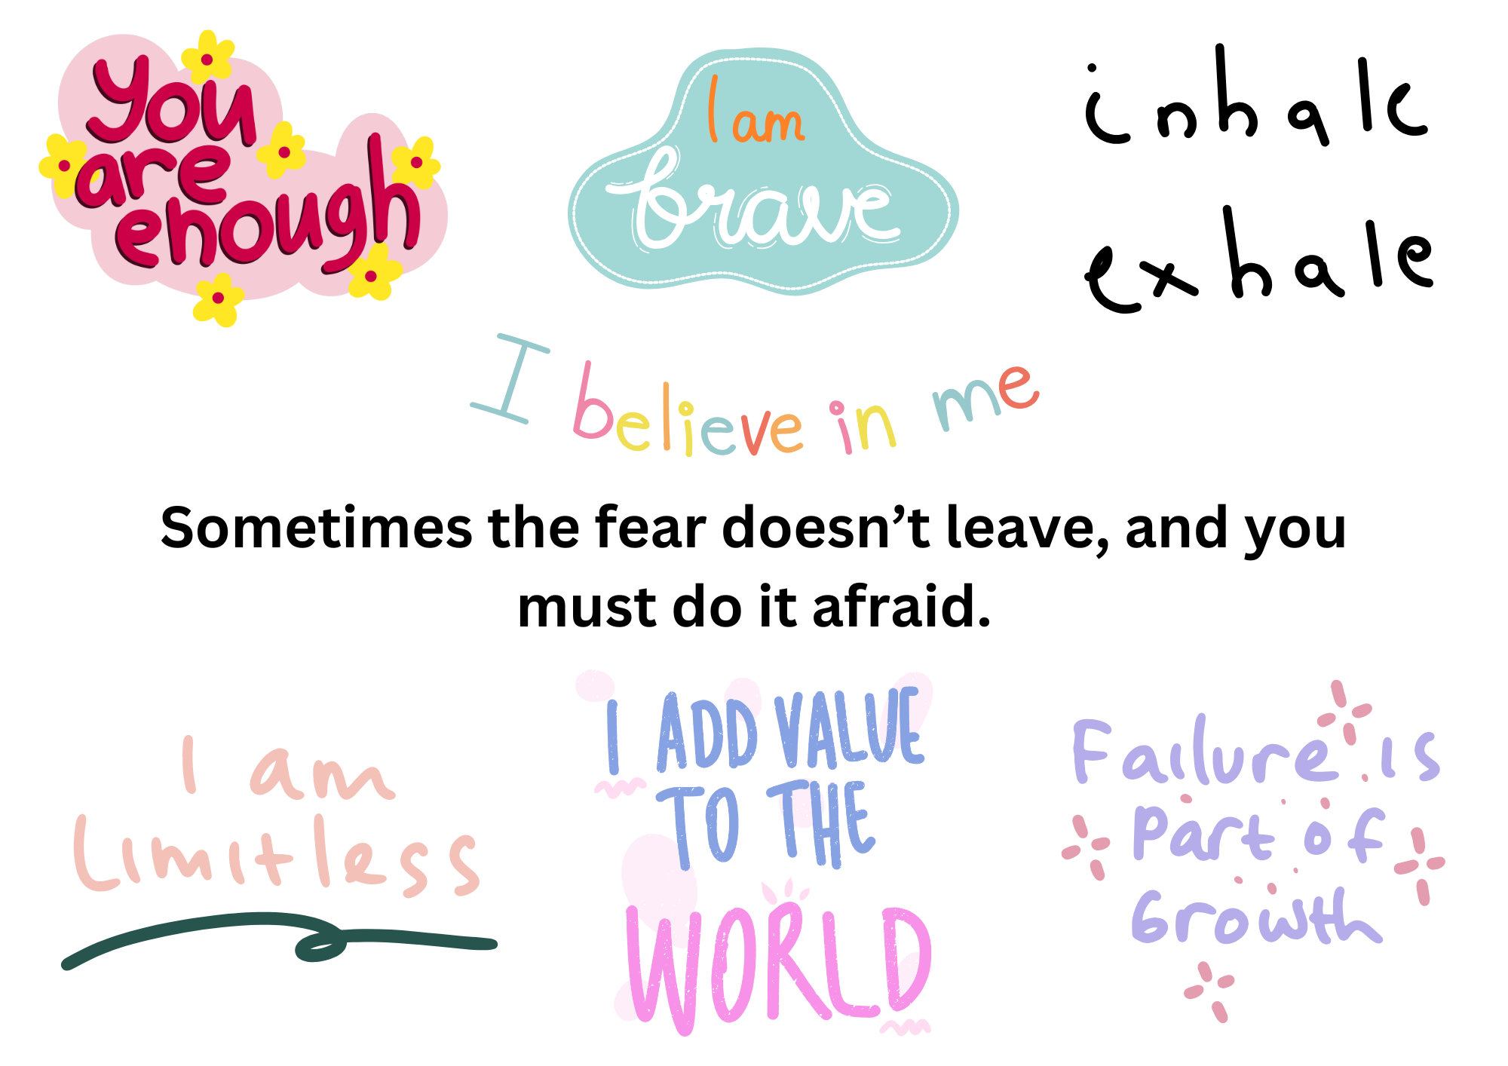

Slide 5
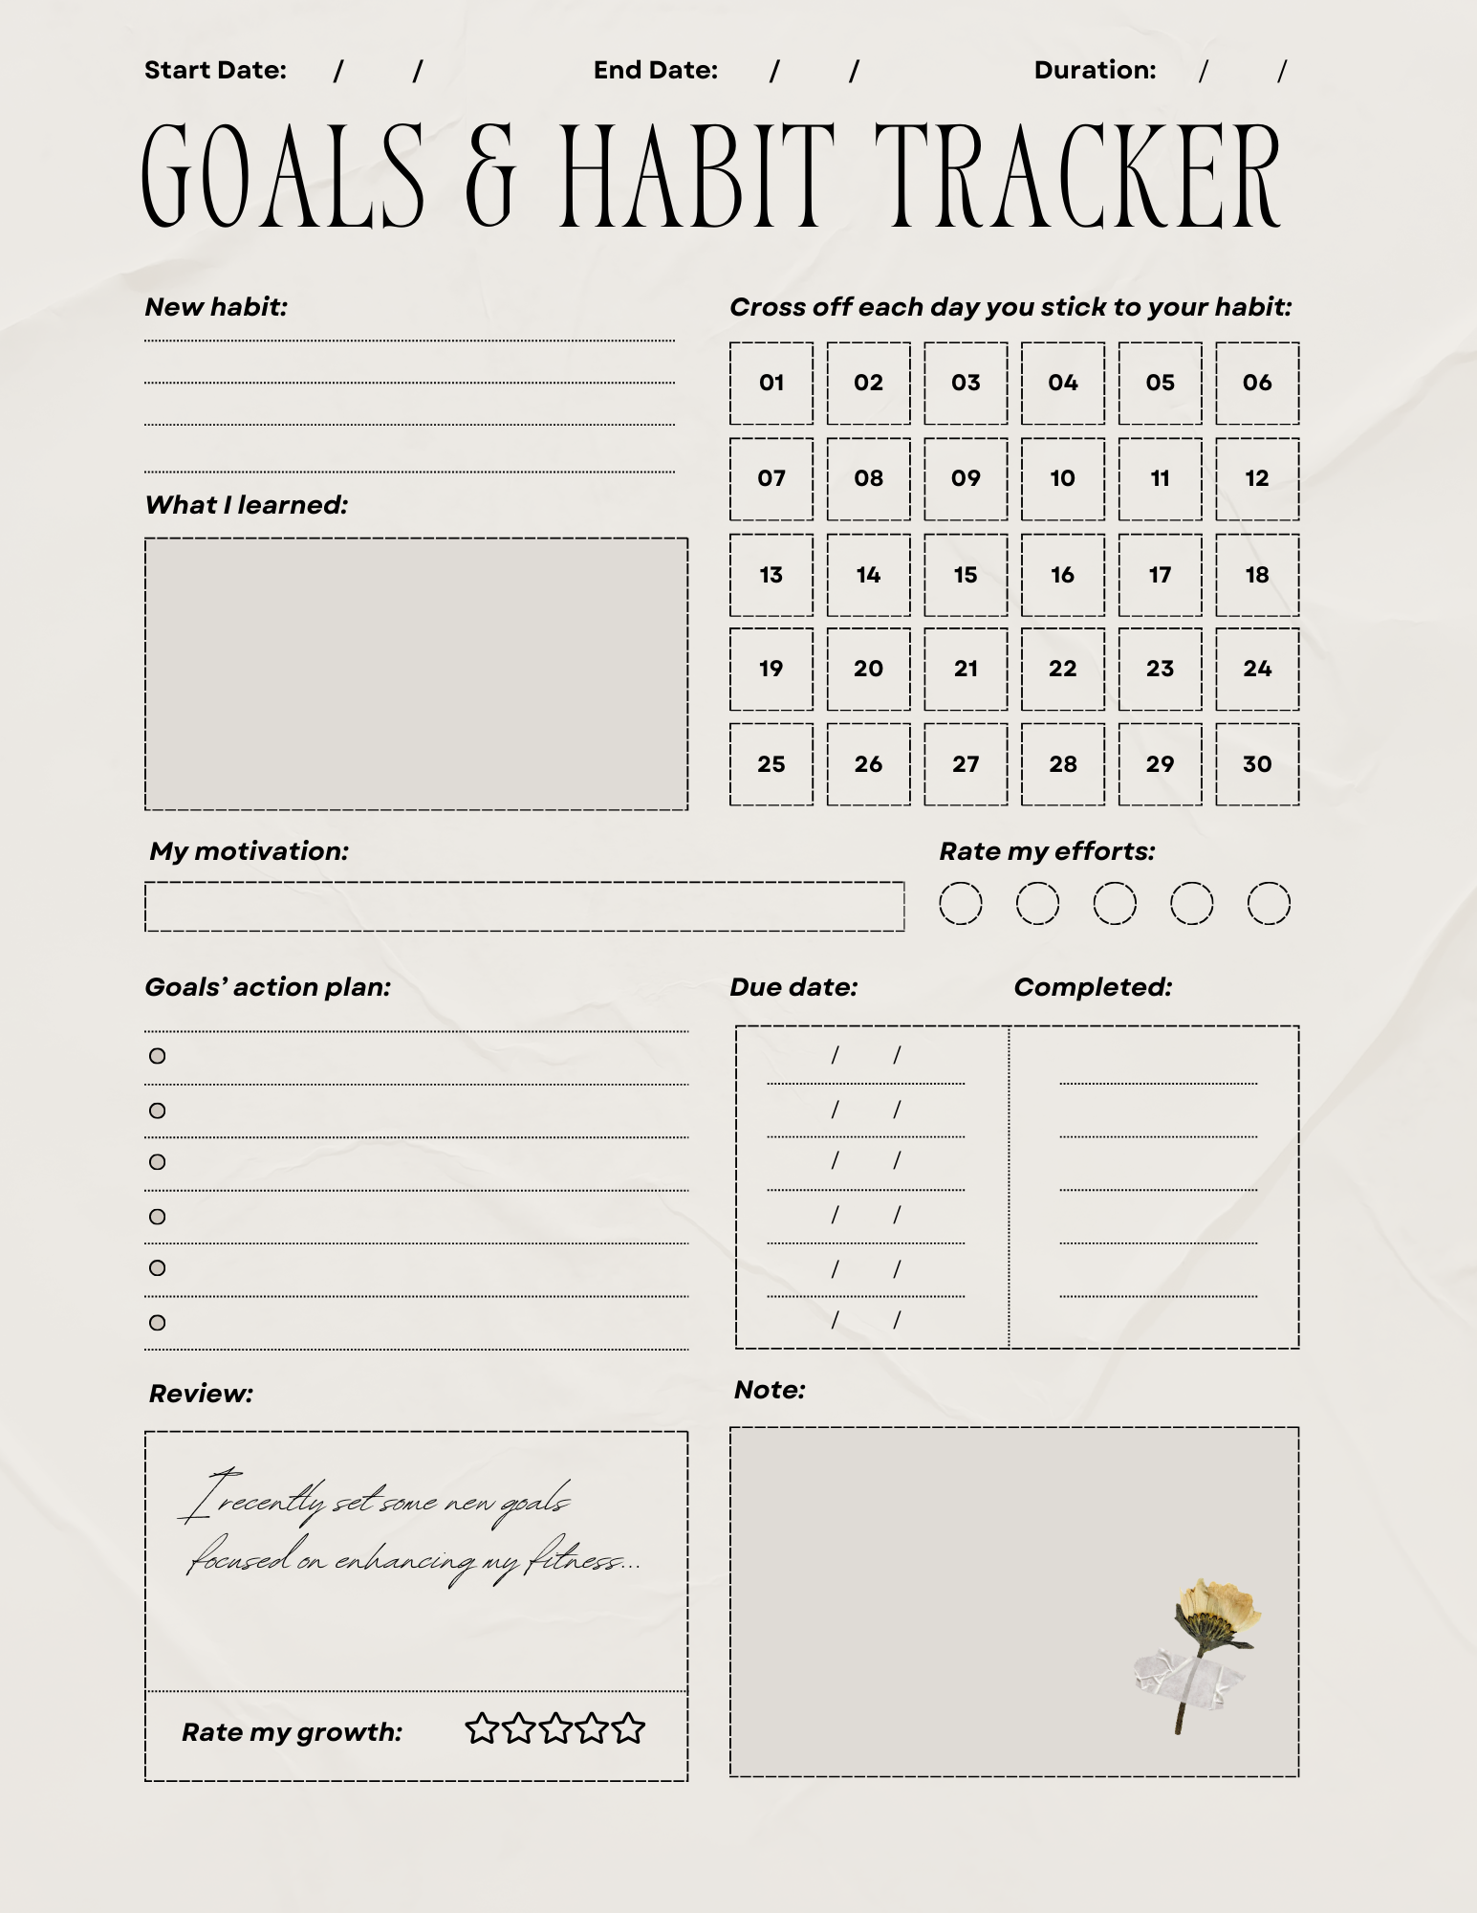
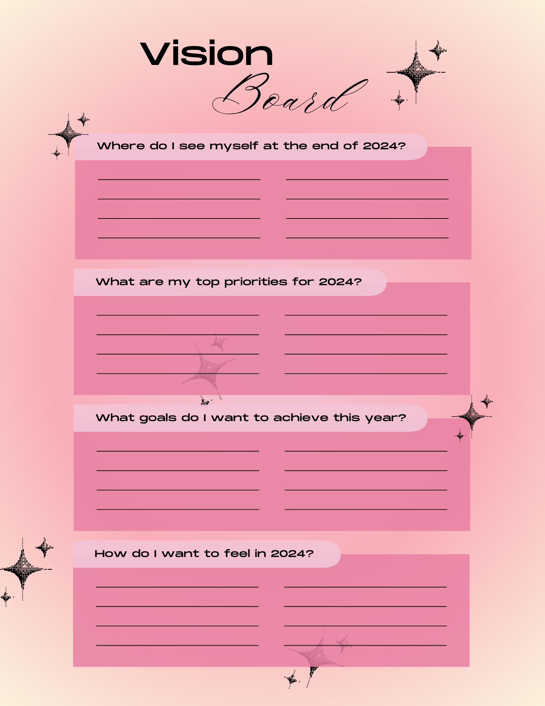

Slide 6
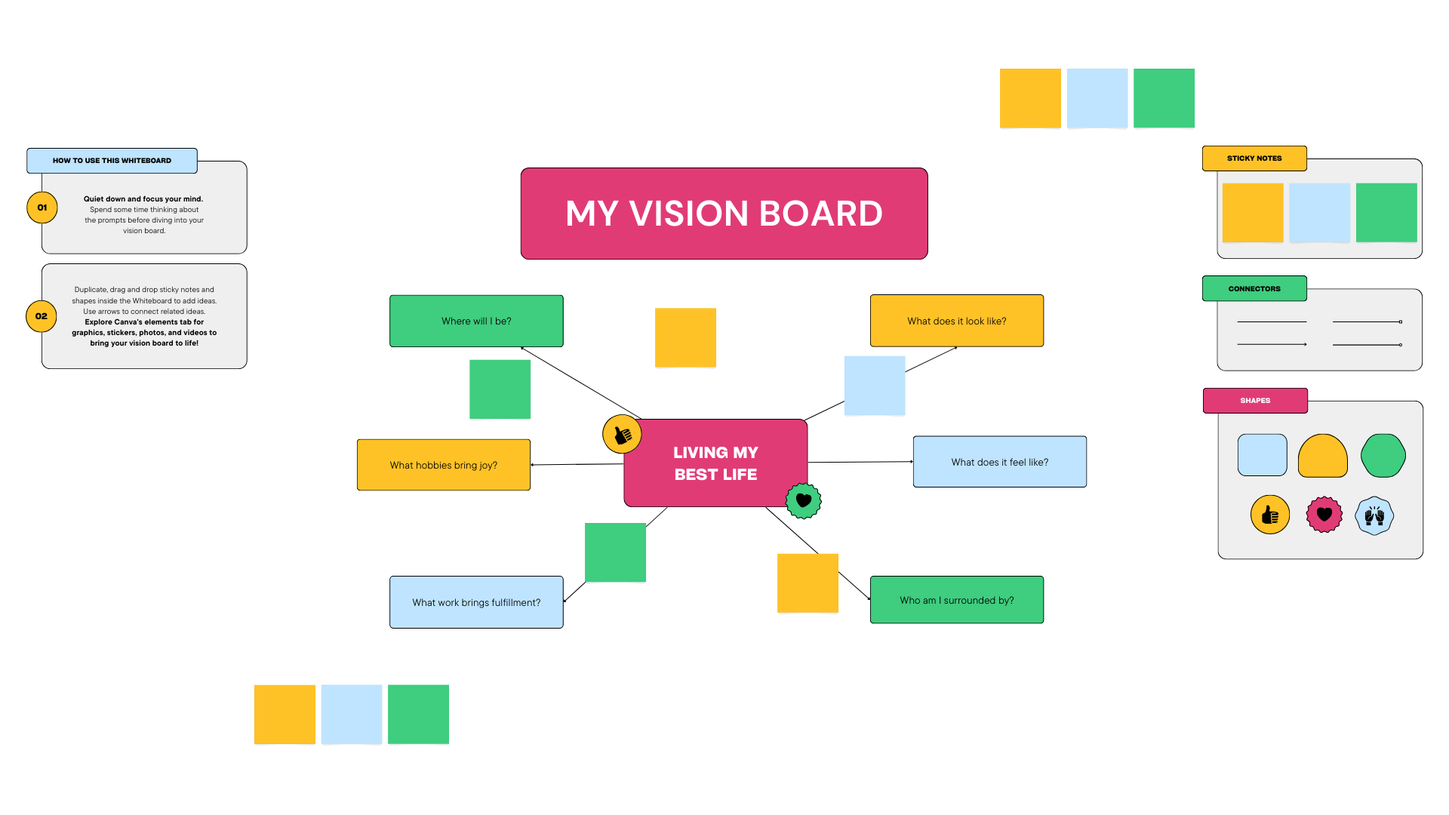

Slide 7
Goals
Your goals do not have to be “big” or fit into the “norm”
Highschool, university, marriage, buy a house, have children
Not everyone wants to get married, have kids, have a “normal” career, or go to a university. Not everyone is able to do these things, and that is okay. However, it is healthy and fulfilling to have goals. It’s important to be a part of your community.
People with disabilities often experience obstacles with these things.

Slide 8
Health Goals
Examples: finding a new doctor, exercising more, eating healthier, mental health, finding more resources and support
What’s the first step to take toward a health goal(s) that you have?
Meredith - find a good seizure doctor in Belgium by April 2025
Kay - go to the YMCA at least 1x a week for the year
Hannah - new breathing machine (hopefully by February)
Bergen - has started already, to figure out some health stuff, appointment in April
Flor - completing eating disorder clinic

Slide 9
Employment Goals
Examples: finding a new job, leaving a job that’s not right for you, getting the accommodations you need, writing a resume
What’s the first step to take toward an employment goal(s) that you have?
Meredith - put on a great 2025 YLF and reach more with disabilities
Kay - more money for YLNC
Hannah - be professional, be more reliable (practice time management)
Tyeshia - happier at job and in general, looking for a new job (wants to work at a library)
Sasi - keep working at Food Lion
Bergen - getting better at interviews (will see career counselor more this year)
Flor - wants to work at Moses Cone hospital, paid position

Slide 10
Education Goals
Examples: applying for school, getting a tutor, finishing a class
What’s the first step to take toward an education goal(s) that you have?

Slide 11
Other/Misc Goals
Examples: making new friends, learning a new skill, learning a new language, brushing your teeth 2x a day, reading more books, getting your driver’s license, financial goals
What’s the first step to take toward one of these goals that you have?

Slide 12
Let’s check-in next time!
If you weren’t able to create a vision board for this LEADing On Series, feel free to make one to share at our February meeting! We will have a short discussion on how your goals are going and for anyone to share their vision board who didn’t this evening!

Slide 13
Job/Volunteer Opportunities
NC SILC membership - https://nc-silc.org/get-involved/
APRIL membership - https://www.april-rural.org/index.php/en/become-a-member/membership-information
APRIL Youth Steering Committee - https://www.april-rural.org/index.php/en/youth/youth-steering-committee
APRIL Youth Advocacy Committee - https://www.april-rural.org/index.php/en/youth/youth-advocacy-committee
Volunteer Match
APRIL - Program Manager
APRIL - Website Designer

