Slide 1
Networking for Career Growth and Combating Stigma for Neurodivergent Individuals
Empowering Young Adults with Non Apparent Disabilities in the Workforce
Dr. Raymond Huml, Patient Advocate and Vice President of Rare Disease Strategy at Sciensus

Slide 2
Why is networking so important?
Networking: Sharing ideas and information to build mutually beneficial professional relationships; social media critical
Benefits:
Access to hidden job opportunities (up to 70% of jobs are not publicly advertised)
Building mentor relationships and career guidance
Developing mutual support systems
Benefit from others who have “been there”

Slide 3
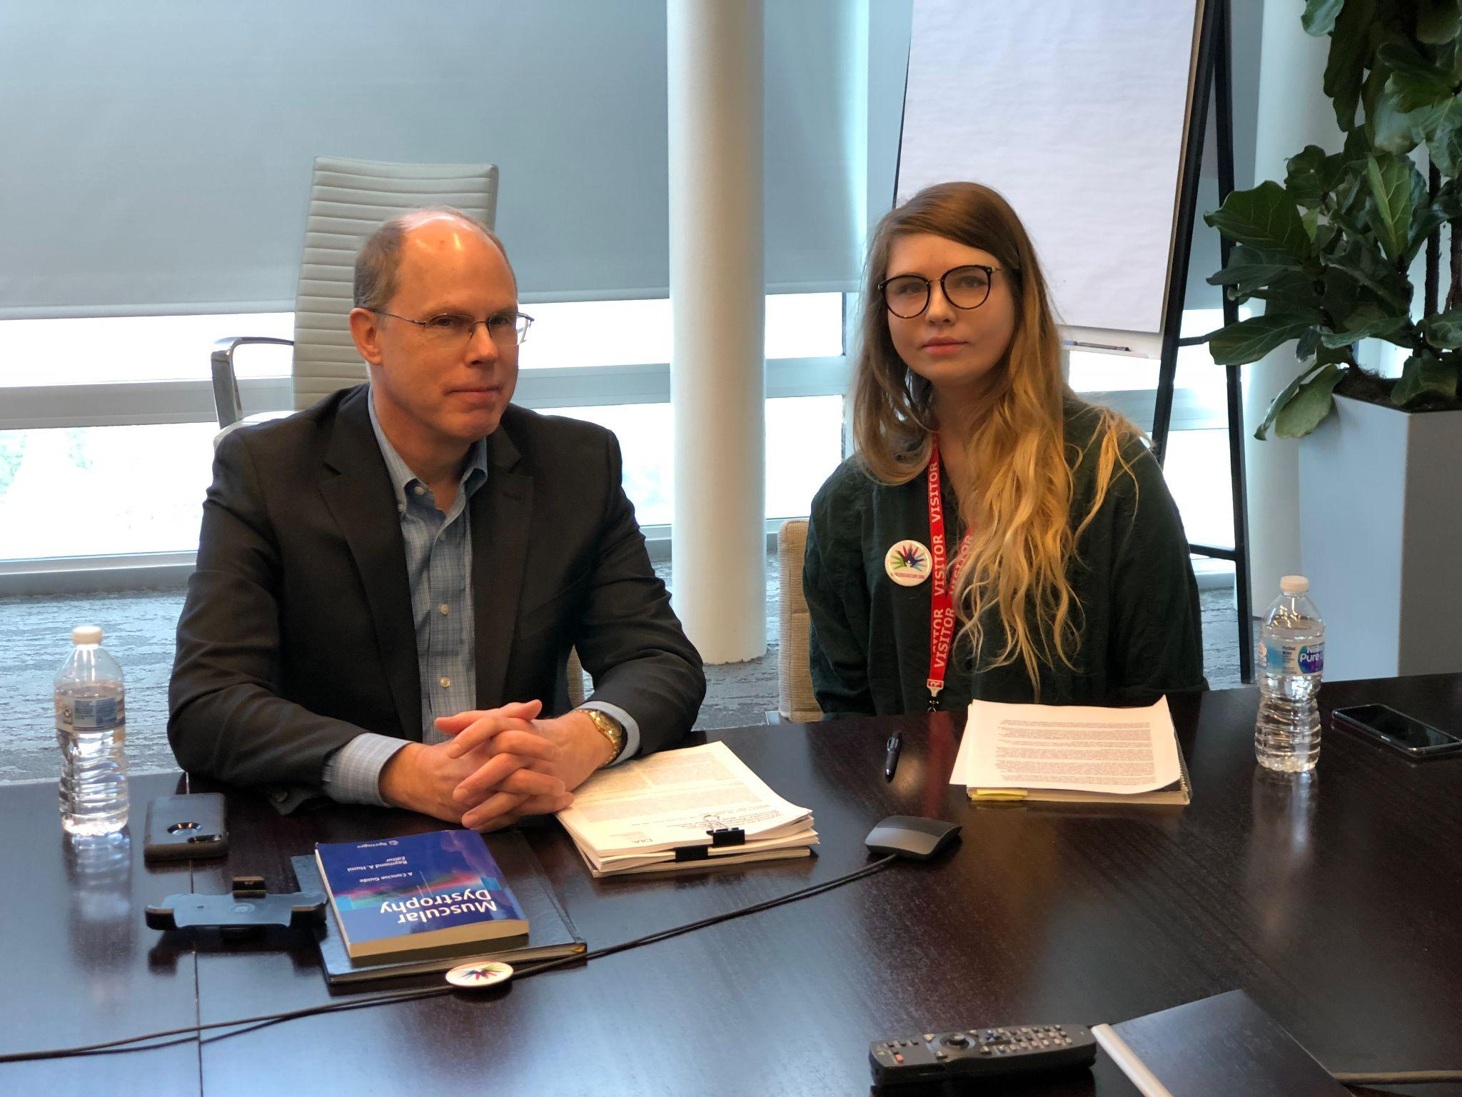
Challenges Faced by Neurodivergent Individuals
Social barriers
Difficulty navigating social expectations
Anxiety or self-doubt in professional settings
Workplace statistics
High unemployment rates among neurodivergent individuals (30–40%)
Only 4% disclose invisible disabilities due to stigma

Slide 4
Effective Networking Strategies for Neurodivergent Professionals at events for networking
Preparation tips
Practice conversations before events
Research attendees' backgrounds and prepare talking points
Event Selection
Choose events with accommodations (virtual options, smaller groups)
Follow up!
Reach out after the event via email or phone to maintain connections and build trust

Slide 5
Combating Stigma Around Invisible Disabilities
Understanding Invisible Disabilities: Examples include ADHD, autism, anxiety disorders, and chronic pain
Challenges Due to Stigma:
Fear of judgment and discrimination
Hesitation in disclosing conditions, leading to lack of support
Advocacy Tools:
- Sharing personal stories through blogs or community events
- Using awareness symbols like the Hidden Disabilities Sunflower badge

Slide 6
Promoting Inclusion in Professional Settings
Strategies for reducing stigmas:
- Suggest training sessions on invisible disabilities for employees and managers
- Advocate for inclusive policies such as flexible work arrangements and accommodations
- Leadership Role: Encourage open communication, empathy, and diversity initiatives

Slide 7
Leveraging Resources for Career Growth
Programs for Neurodivergent Professionals:
- Transitions USA offers networking courses tailored to neurodivergent individuals, featuring role-playing exercises and communication training
- Online Platforms: LinkedIn groups for neurodiverse professionals
- Companies with Neurodiversity Initiatives

Slide 8
Overcoming Social Anxiety in Networking
Tips for Managing Anxiety:
Practice positive self-talk before events ("Everyone is here to connect").
Focus on meaningful conversations rather than perfection during interactions.
Try recording your “elevator pitch” beforehand and have a trusted friend review it.

Slide 9
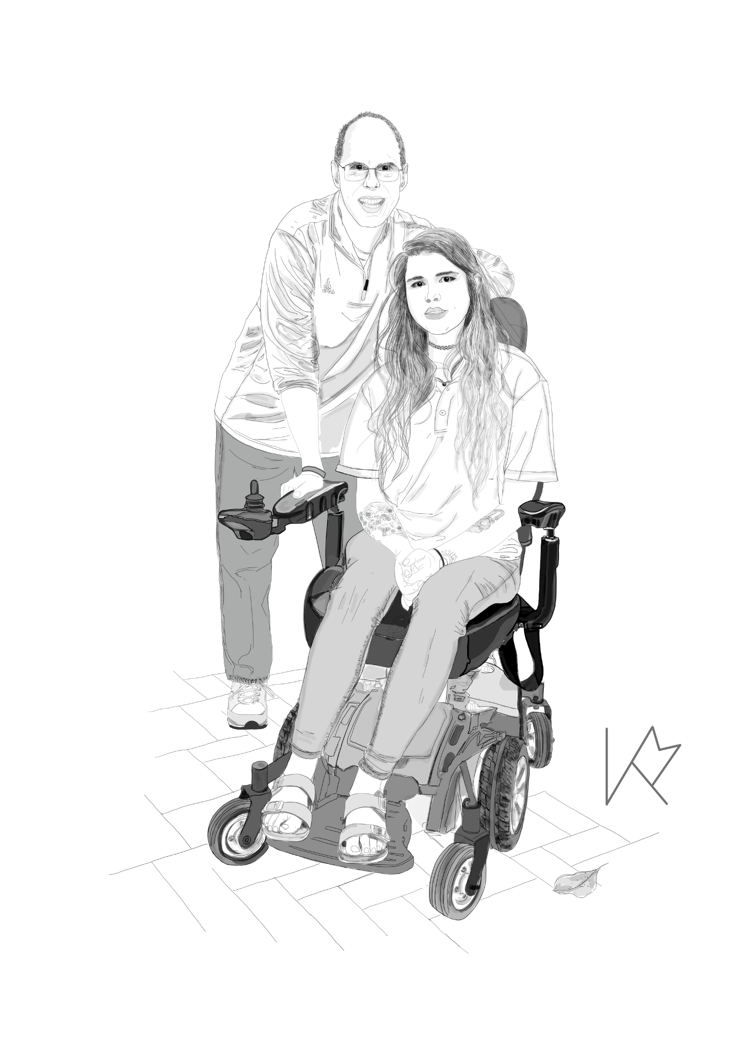
Call to Action
Develop your network
Review You Tube/LinkedIn Videos about networking
Create a mental list of potential accommodations that you may require
Create a resume knowing that AI tools will be first reviewing it
Identify a trusted partner to help you
Never give up!

Slide 10
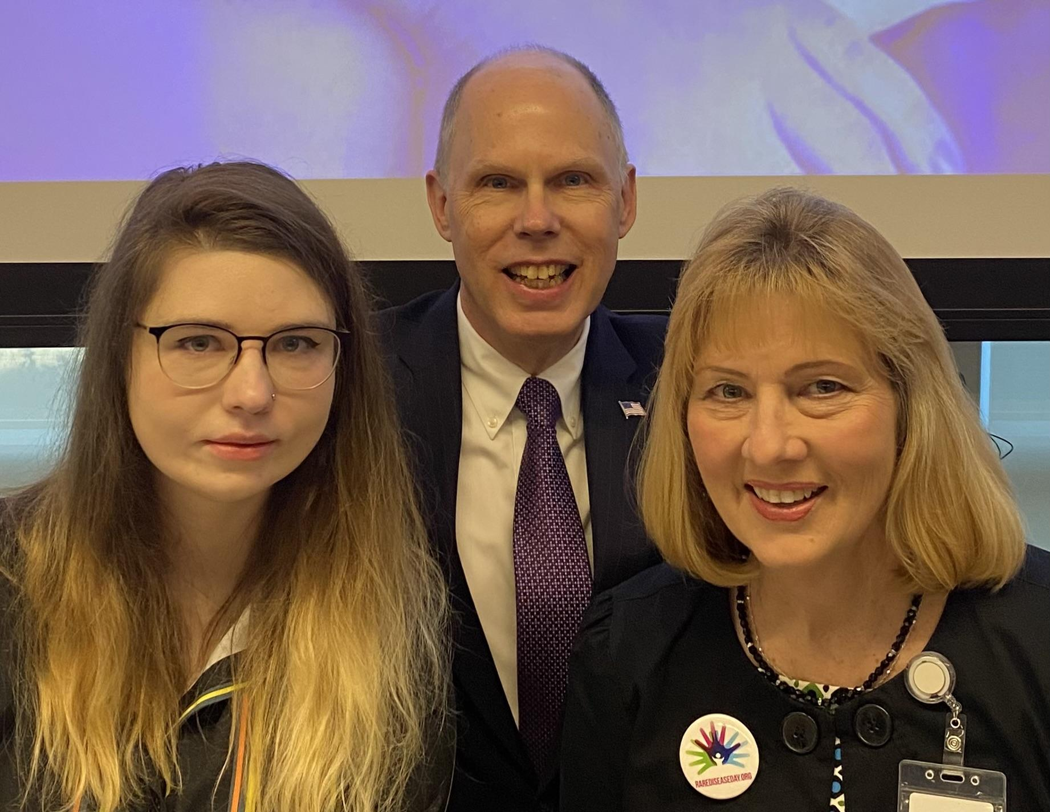
Thank you!

