Slide 1
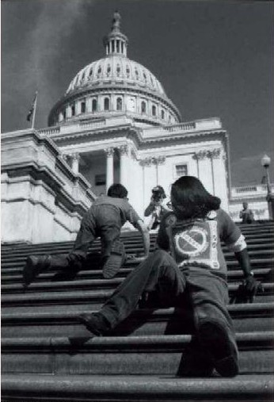
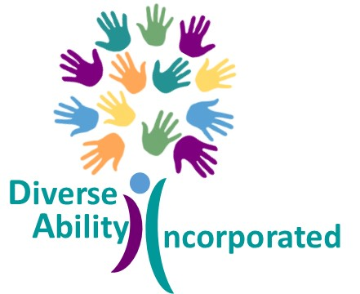
Disability History,
Culture, and Pride
A Workshop
By and For Youth
©Diverse Ability Incorporated

Slide 2
Diversity
Diversity means variety, mixture, assortment.
In the context of people, diversity is a combination of attributes, qualities, and features that make up the identity of a person. This means that all the things that influence your life, and how you move through the world, makes you uniquely who you are.
Although people have some of the same diversities, every person is exactly who they are, and no one is exactly like anyone else, even though they may have things in common.
Just like there is variety in cars, cell phones, and video games, there is variety in people.

Slide 3
Why is Understanding Diversity Important?
Understanding diversity helps us better know and appreciate (be grateful for) ourselves and other people.
It opens our minds to thinking about how and why we navigate through life the way we do, and how that may be similar or different for others.
It also helps us solve problems. Have you ever worked together with someone, and they had ideas that you never would have thought of on your own? It may have been their diversity, an element from their unique life experience, that made that possible.
Diversity makes us who we are individually and strengthens us all.
Understanding diversity helps us approach others with fairness, compassion (kindness and concern), and empathy (being able to sense or imagine how someone else thinks or feels).

Slide 4
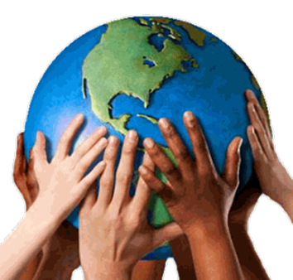
Diversity enriches our lives because it brings together many different perspectives (thoughts or ideas about what something means to you), which often helps us to make wise choices and decisions.
Instead of being confused or irritated when someone responds differently than we do, or than we are used to people responding, we can respond in a way that welcomes all perspectives and work together to solve problems.
When we embrace diversity, we can change the world around us for the better!
https://www.youtube.com/watch?v=4z7gDsSKUmU

Slide 5
Diversity and History
The world is a complicated place, and throughout history, people have made note of their differences, leaving others to feel like they don’t belong, or even like they are less than. We cannot change what happened yesterday, we can only try to do better right now.
People who have similarities have joined together around what they have in common for as long as people have been around. This has also made others feel alone and isolated.
Through technology, we have greater connection to the larger community today, and we can see the truth: we are more alike than we are different; we are stronger together; there is room for all of us; everyone wins when everyone is included.
We can all learn from history.

Slide 6
History Snapshot: Human Rights
Human Rights are rights, which are like freedoms or protections under the law, which you have because you’re a human being. Human Rights ensure that people can live freely and that they are able to flourish or grow, reach their potential, and participate in society. They ensure that people are treated fairly and with dignity and respect. You have human rights simply because you are human, and they cannot be taken away.
Adapted from: https://humanrights.gov.au/introhumanrights/resources/lesson_2.pdf
Human Rights:
are for everyone
are protected by law
are international, meaning they are the law all around the world
focus on the well being and dignity or value of each human being
protects individuals and groups
cannot be taken away
Human Rights: https://www.youtube.com/watch?v=7M0banVOMas

Slide 7
The Universal Human Rights

Slide 8
History Snapshot: Civil Rights
Civil rights are rights that are granted to citizens by a government. For example, governments may decide who can vote, who can buy property, or who can be educated. In America, the Bill of Rights of the U.S. Constitution lists many of these rights.
https://kids.britannica.com/kids/article/civil-rights/352966
Civil Rights have been denied to people throughout history
Many groups have advocated or demanded their civil rights
The Civil Rights Movement of the 1950’s and 1960’s centered around black or African-American people advocating for their civil rights
Following the Civil Rights Movement of the 1950’s and 1960’s many other groups of people who were oppressed or treated unfairly, began advocating for their civil rights
Other racial groups, women, people who have disabilities, and people who are part of the LGBTQ+ community all have better protected civil rights because of the hard work that happened in the 1950’s and 1960’s, and the path those determined Americans created were a benefit to us all.
Civil Rights: https://www.youtube.com/watch?v=tT3EIKmKpaQ

Slide 9
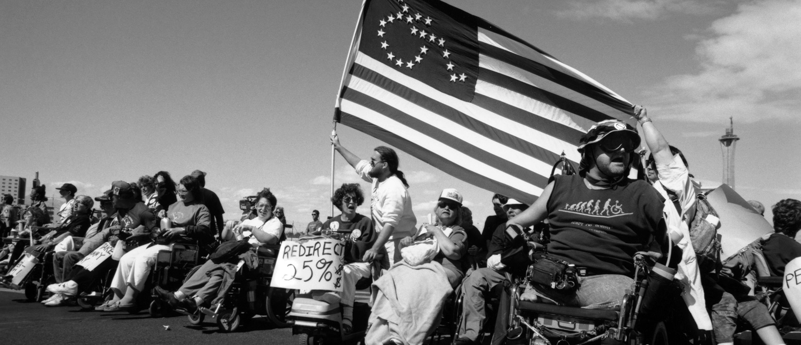
The Fight for Disability Rights
https://www.youtube.com/watch?app=desktop&v=qXD7TckuVjM&t=9s
https://youtu.be/ci3ek-tqiGQ
https://youtu.be/El_qTr3L0G0

Slide 10
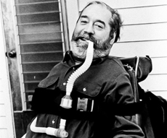
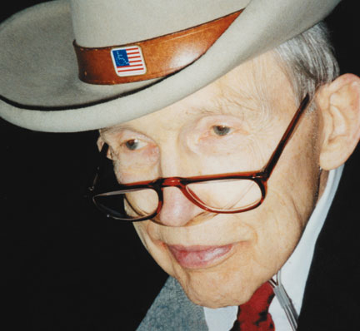
Disability Rights Heroes
Edward Verne Roberts (January 23, 1939 – March 14, 1995) was an American activist. He was the first student who had a significant disability to attend the University of California, Berkeley. He was a pioneering leader of the disability rights movement. Ed Roberts is often called the father of the Independent Living movement. Hundreds of Centers for Independent Living around the world are based on his model.
Justin Whitlock Dart Jr. (August 29, 1930 – June 22, 2002) was an American activist and advocate for people who have disabilities. He helped to pass the Americans with Disabilities Act (ADA) of 1990, co-founded the American Association of People with Disabilities (AAPD), and is regarded as the "Godfather of the ADA."

Slide 11
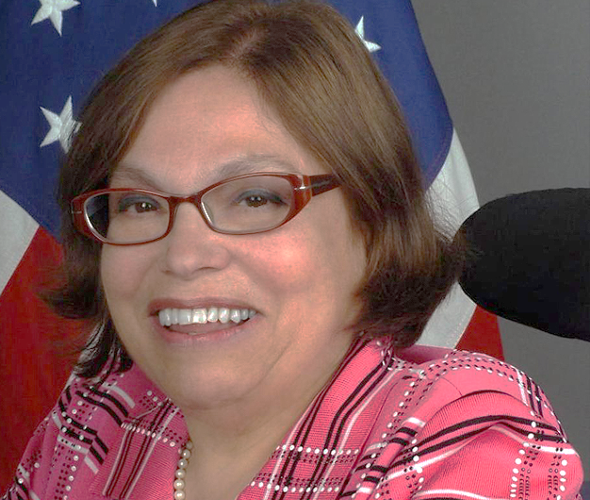
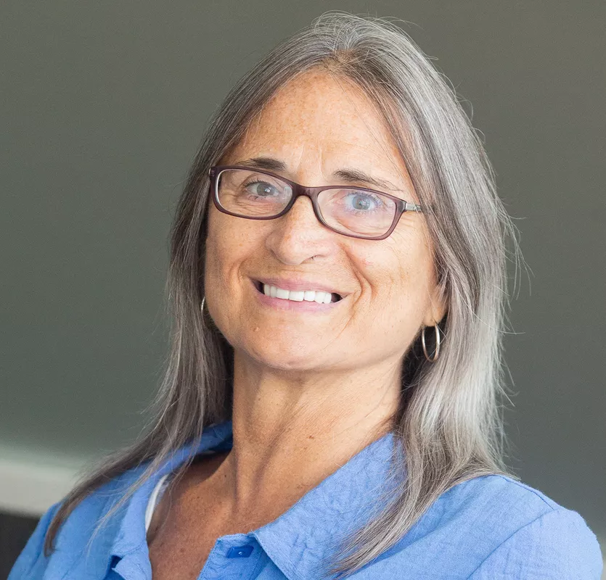
Judith Ellen “Judy” Heumann (December 18, 1947-March 4, 2023) was an International disability rights activist, recognized as a lifelong civil rights advocate for people who have disabilities. Her work with governments and non-governmental organizations (NGOs), non-profits, and various other disability interest groups, starting in the 1970’s produced significant contributions to the development of human rights legislation and policies benefiting children and adults who have disabilities.
Marca Bristo (June 23, 1953-September 8, 2019) founded a Center for Independent Living in Chicago, co-founded the National Council on Independent Living (NCIL), helped to write the Americans with Disabilities Act of 1990, was the first person to serve as Chair of the National Council on Disability, and was President of the International Council on Disabilities.

Slide 12
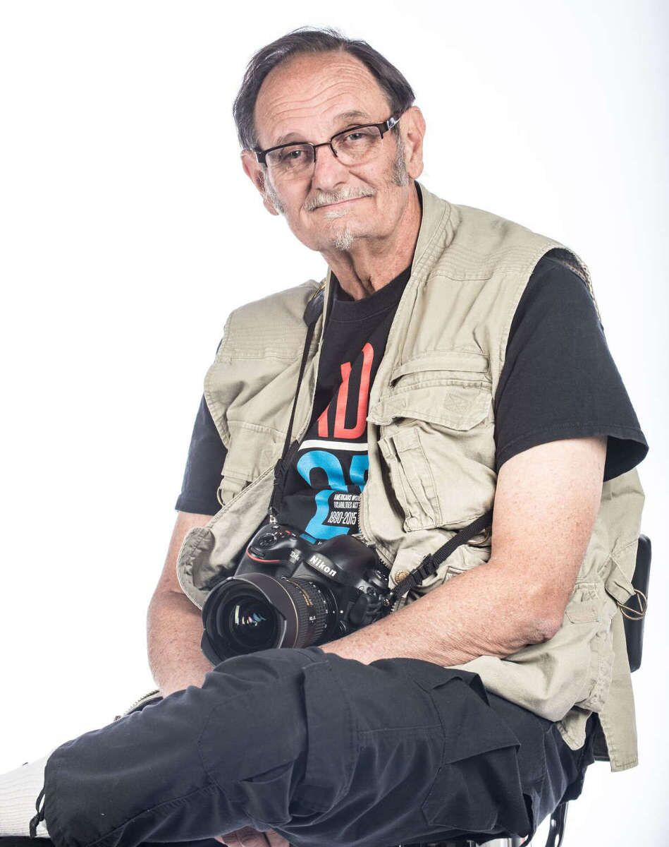
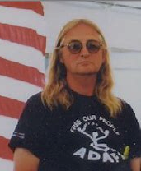
Tom Olin is the person behind the lens who captured many of the most significant moments in disability rights history. Equipped with his camera and some black-and-white film, Tom is renowned as the Rights Movement Documentarian and Activist, who has spent his life in the grassroots, building an incredible collection of iconic photos of our historic struggle for civil rights and inclusion.
Wade Blank (December 4, 1940-February 15, 1993), founded ADAPT, a grassroots disability rights organization, with chapters in 30 states. ADAPT uses nonviolent direct action, including civil disobedience, when necessary, in order to bring attention and awareness to the lack of civil rights experienced by people who have disabilities. ADAPT also now practices legislative policy advocacy, grassroots education and mobilization, and individual members may engage in legal advocacy.

Slide 13
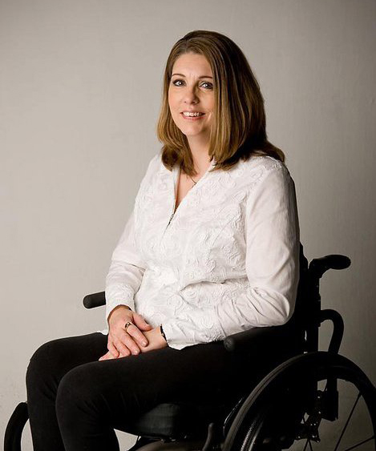
Arizona Disability Heroes
Representative Jennifer "Jen" Longdon is an American politician and a Democratic member of the Arizona House of Representatives. Jen acquired her spinal cord injury after surviving a random drive-by shooting. Jen is a tireless advocate for disability rights and gun violence prevention, who has spearheaded grassroots efforts and advanced policy change at the local, state, and national level.
Bob Michaels began working in the field of disability in 1972. Initially, Bob developed and implemented programs in the fields of mental health and developmental disabilities. He served as Executive Director for two Centers for Independent Living and spent much of his career as a National Consultant and Trainer. Bob is an advocate, a blogger turned author, and has contributed considerably to the training and technical assistance field of Independent Living. Bob is now retired and was the Chair of Arizona Statewide Independent Living Council (AZSILC) when the State Plan for Independent Living was amended to include Arizona Youth Leadership Forum (AZYLF).

Slide 14
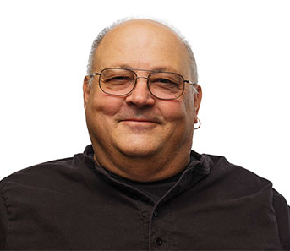
Arizona Disability Heroes
Fernando Cruz (1954-2015) was a proud member of the Tohono O’odham Nation, who assisted hundreds of individuals to transition from long term care facilities to independent lives within the community. In addition, Fernando provided Emergency Preparedness Training for people who have disabilities who live on Tribal Land throughout the state of Arizona.
Tony DiRienzi (1944-2020) was a talented artist who created beauty in many mediums, and who mentored hundreds of people who had newly acquired disabilities along their journeys. As the Executive Director of Arizona Statewide Independent Living Council for a decade, Tony was instrumental in statewide efforts related to Emergency Preparedness for people who have disabilities, a legacy that continues today.

Slide 15
Disability Pride (from disabled-world.com)
People who have disabilities are the largest and most diverse minority within the population, representing all abilities, ages, races, ethnicities, religions and socio-economic backgrounds.
Disability Pride has been defined as accepting and honoring each person's uniqueness and seeing it as a natural and beautiful part of human diversity.
Disability Pride is an integral part of movement building, and a direct challenge of stigmatizing definitions of disability.

Slide 16
Discussion Questions
Discussion
How do you feel disability history applies to your life?
How do you feel after learning more about the disability rights movement?
How are you involved, or how could you become involved in the Arizona disability community?
How do you plan to make some history of your own?

